Slide 1
NLP Applications——
Text Summarization
Han Xiong
Springboard DSC

Slide 2

Text Summarization
A technique in NLP to condense text into a shorter version while retaining key information. It helps users grasp main points efficiently.

Slide 3

Summarization Methodologies
Extractive Summarization: Selects important sentences from the original text to form a summary.
Latent Semantic Analysis
TextRank
Embedding-based summarization
Abstractive Summarization: Generates new sentences to create a concise summary.
Seq2seq models
Transformers

Slide 4
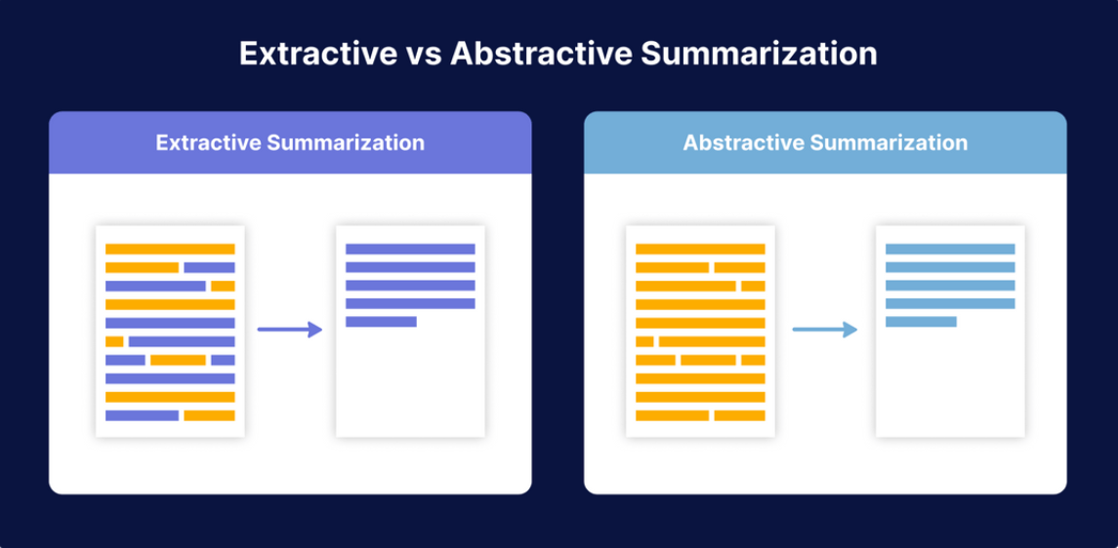
Summarization Methodologies

Slide 5
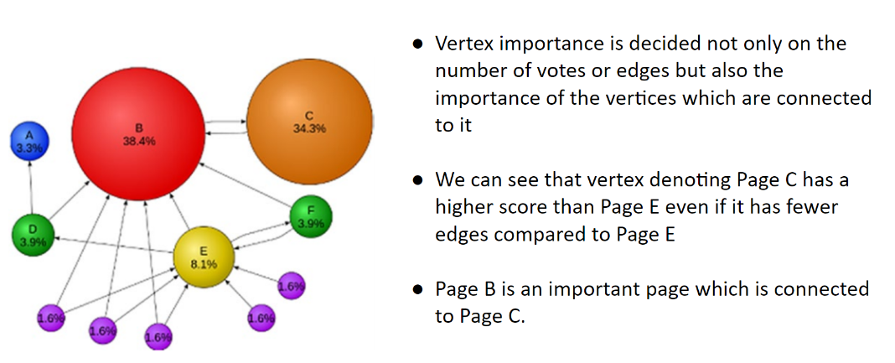

Extractive Summarization
Understanding PageRank

Slide 6
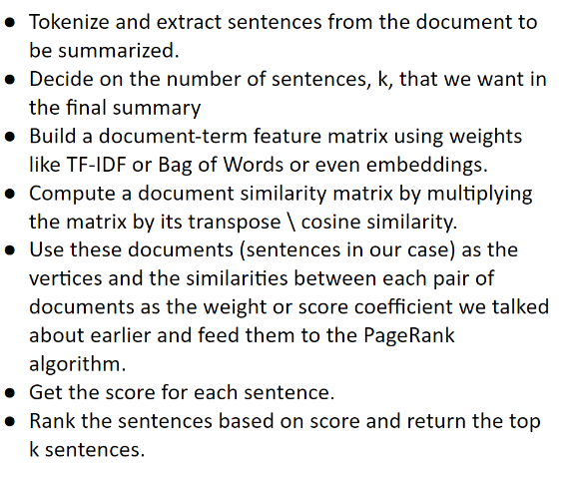
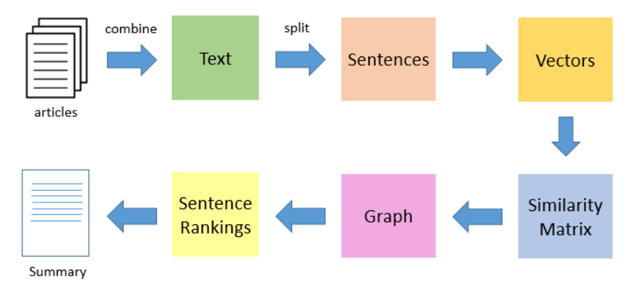
Extractive Summarization
TextRank Workflow

Slide 7
Extractive Summarization
Extractive Summarization with TextRank
PROS
CONS
Simplicity
Language-agnostic
Unsupervised approach
Reduces redundancy
Extractive approach
Limited context understanding
Sentence length bias
Lack of global optimization
Sensitivity to parameters
Difficulty with handling noisy text

Slide 8
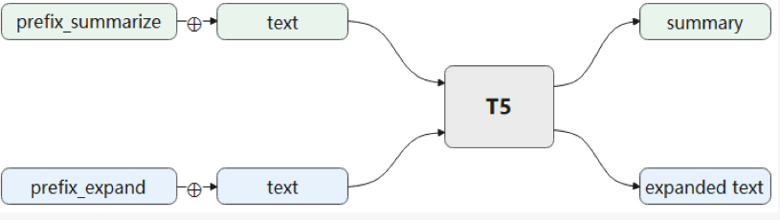
Abstractive Summarization
T5 model with different prefixes
1. Install the transformers library
2. Import the library
3. Configure the GPUs and model to be used.
4. Specify the text to be summarized.
5. Use a summarizer to summarize the content.

Slide 9
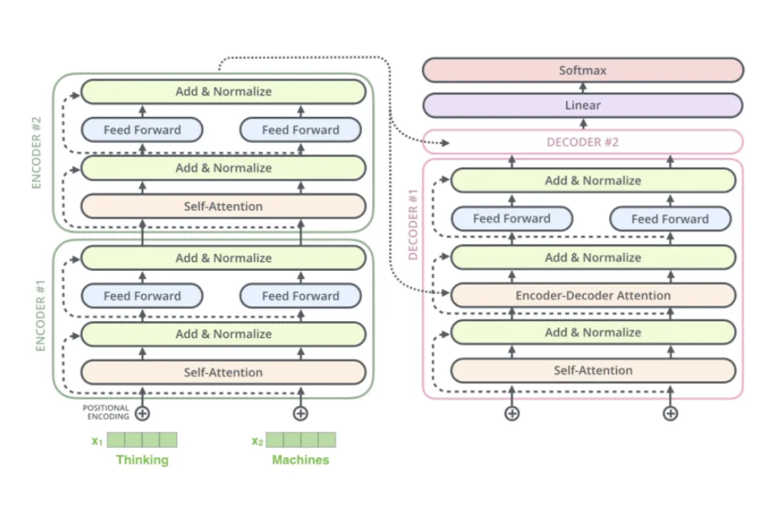
Abstractive Summarization
T5 architecture

Slide 10
Abstractive Summarization
Abstractive Summarization with T5
PROS
CONS
High performance Language-agnostic
Flexibility
Contextual understanding Reduces redundancy
Long-range dependencies
Few-shot and zero-shot learning
Training data requirements
Potential biases
Length control
Abstractiveness
Ambiguity handling

